Slide 1

TSM_MobOp Mini Project
Augmented City Finder ACF
NILS FREY
13.04.2015
LUCAS GRAF
THOMAS STREBEL

Slide 2
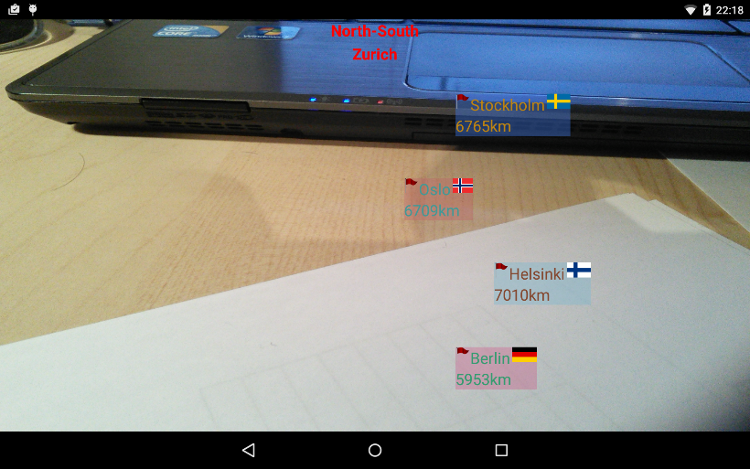
Introduction – What is ACF?
Informational funny Android App
The App
  Gets the current device location
  Displays the distance to a certain cities
    User specifies cities to display
    User can add new cities
  Displays the cities directly on the image of the front camera
    Dependening on the direction of the camera
  Offers the user to tap on a city
    Tap will display specific information about the city
    User can set up which information should be displayed
13.04.2015
ACF: NILS FREY, LUCAS GRAF AND THOMAS STREBEL

Slide 3
Introduction - Motivation
For the user
  Funny App
  Informational App
  Display information the user is interested in
For the App provider
  Knows its users
    Device location will be sent to the server
  Knows the interests of its users
    Added cities, city groups and displayed information will be sent to the server
  Knows the behaviour of its users
    City taps will be sent to server
  Can display specific advertisement
13.04.2015
ACF: NILS FREY, LUCAS GRAF AND THOMAS STREBEL

Slide 4
Introduction – Goal statement
Time budget: 3 * 30h = 90h
Only limited functionality
  Add, edit and delete new cities and groups
  Get the current device location
  Calculate the distance to the cities
  Display cities and distance directly in the camera depending on the device direction
  Register taps on cities
  Develope an appropriate server (including DB)
    Get default cities, countries, continents and groups from the server
    Store specific cities, groups and taps on cities on the server
13.04.2015
ACF: NILS FREY, LUCAS GRAF AND THOMAS STREBEL

Slide 5

Related Work
junaio Augmented Reality
  Displays events and public places nearby
  No user specific
  App does not only display places
    AR Games
    Navigation (map)
    Scan products for information (board games, QR-codes, …)
    Integration of contents (like ebay, twitter, …)
13.04.2015
ACF: NILS FREY, LUCAS GRAF AND THOMAS STREBEL

Slide 6
Implementation
Serverside
  Free OpenShift Cloud Server
    JBoss Application Server 7
    PostgreSQL 9.2
    Sun Jersey (Java API for RESTful Webservices)
Android
  Supported versions from 4.1.0 (Jelly Bean)
  Read sensors and compute azimuth, pitch, roll
  View components
  Camera overlay
  Observer Pattern for location and orientation of device to camera view
  Synchronisation of threads for communication with server and UIThread
    AsyncTasks
13.04.2015
ACF: NILS FREY, LUCAS GRAF AND THOMAS STREBEL

Slide 7
Testing
Manually tested
  All members of the group
  Installed on devices of friends & family
First, there were some errors
  Exception handling was not proper implemented
    Cleaned up
  Too many updates of the city positition on the screen
    Update now depends on a minimal angle
Fixed and tested again
  Some server issues
    Server is not always reachable
    Issue is not caused by implementation
13.04.2015
ACF: NILS FREY, LUCAS GRAF AND THOMAS STREBEL

Slide 8
Summary of Achievements
Add, edit and delete new cities and groups
Get the current device location and post it to the server
Calculate the distance to the cities
Display cities and distance directly in the camera depending on the device direction
Register taps on cities and isplay detailed informations
Communication with the server
Develope an appropriate server
Initialize system cities and groups from the server on first use of app
13.04.2015
ACF: NILS FREY, LUCAS GRAF AND THOMAS STREBEL

Slide 9
Lessons learnt
Serverside
  JBoss Application Server 7
  PostgreSQL 9.2
  Sun Jersey (Java API for RESTful Webservices)
Android
  First Android App
  SQLite
  Gson (Server communication)
  Sensors
  Camera Overlay
  View Components
  Threads in Android and synchronisation
13.04.2015
ACF: NILS FREY, LUCAS GRAF AND THOMAS STREBEL

Slide 10
Future Work
Add more flags
Offer different information to display and let user choose which to display
  Weather
  Sights
  Restaurants
  …
Evaluate user behaviour on server
Display specific advertisement (e.g. hotel rooms, flights, events …)
  Based on user behaviour and interests
Optimize placement of citys on camera view
Mechanism that allows the user to reinstall the app without data loss
Optimize security
  Currently every user can CRUD the collected data on the server (via the REST interface)
13.04.2015
ACF: NILS FREY, LUCAS GRAF AND THOMAS STREBEL

Slide 11

Demo
13.04.2015
ACF: NILS FREY, LUCAS GRAF AND THOMAS STREBEL

